Slide 1
Evaluating LLM Trained on Code
Article Presentation-Fall 2023

Slide 2
Codex introduction
Scalable sequence prediction models
GPT-3 could generate simple programs from Python docstrings.
task of generating standalone Python functions from docstrings, and evaluate the correctness of code samples automatically through unit tests.
create a dataset of 164 original programming problems with unit tests.
Generate multiple samples from the model.

Slide 3
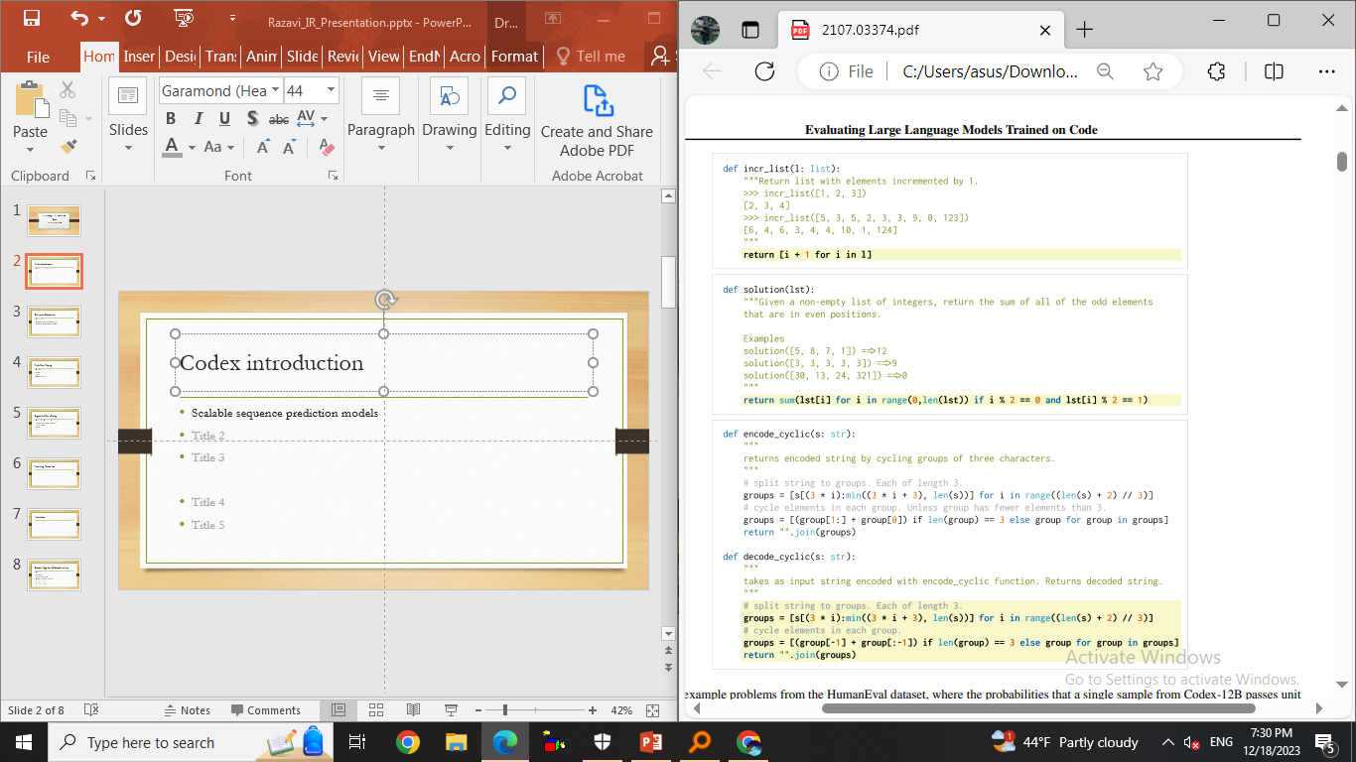
Basic Example

Slide 4
Evaluation Framework
Functional Correctness
HumanEval: Hand-Written Evaluation Set
Sandbox for Executing Generated Programs

Slide 5
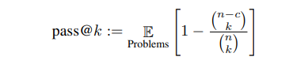
Evaluation Framework - contd
Functional Correctness
Using pass@k metric (k code that generated)

Slide 6
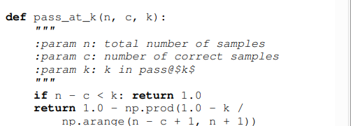
Evaluation Framework(pass@k) - contd

Slide 7
Code Fine-Tuning
Data Collection
Methods
Results
Comparative Analysis

Slide 8
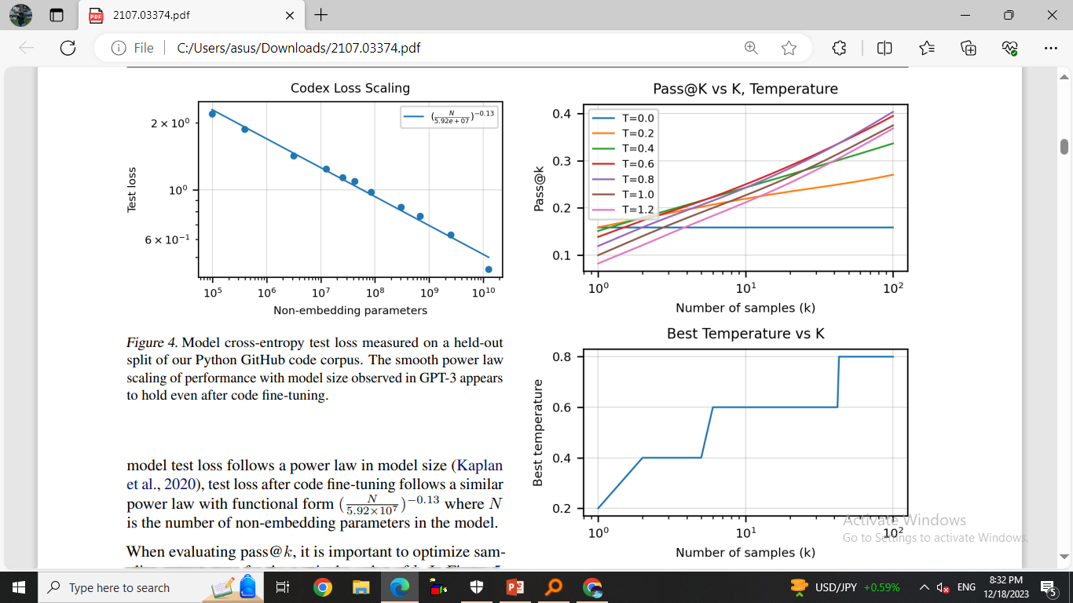
Code Fine-Tuning

Slide 9
Code Fine-Tuning

Slide 10
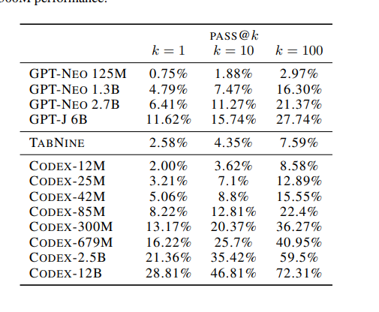
Code Fine-Tuning

Slide 11
Supervised Fine-Tuning
Problems from Competitive Programming
Problems from Continuous Integration
Filtering Problems
Methods
Results

Slide 12
Docstring Generation
generate docstrings from code
docstrings in our dataset may be lower quality because developers tend to devote less time to writing docstrings.

Slide 13
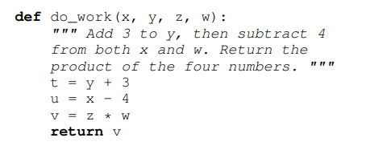
Limitations

Slide 14
Broader Impacts and Hazard Analysis
Over-reliance
Misalignment
Bias and representation
Economic and labor market impacts
Security implications
Environmental impacts

Slide 15
Some Examples of Codex-12B
We show 8 random problems from HumanEval along with 8 random samples per problem generated from Codex-12B at temperature 0.8.

Slide 16
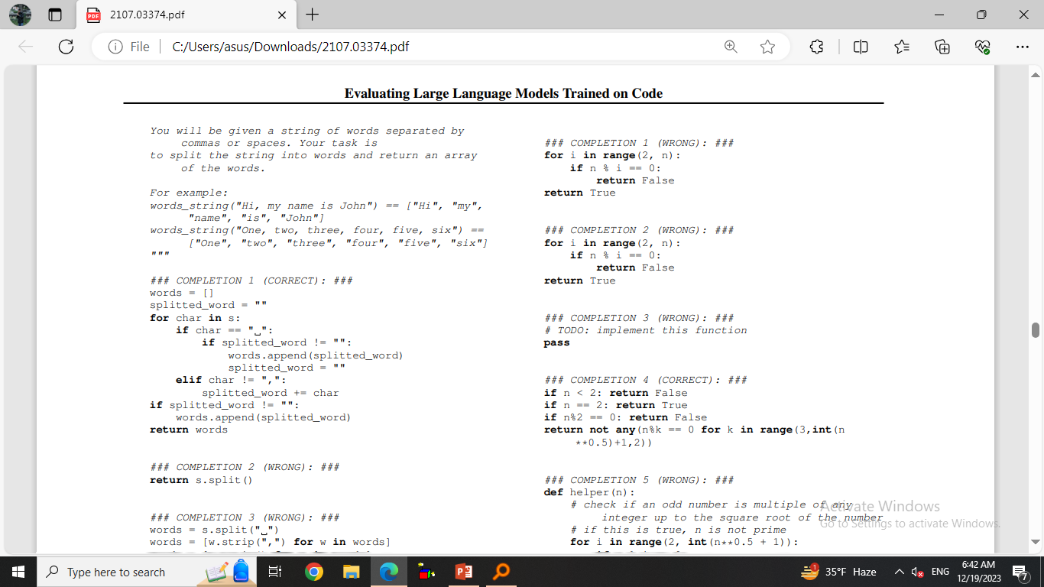
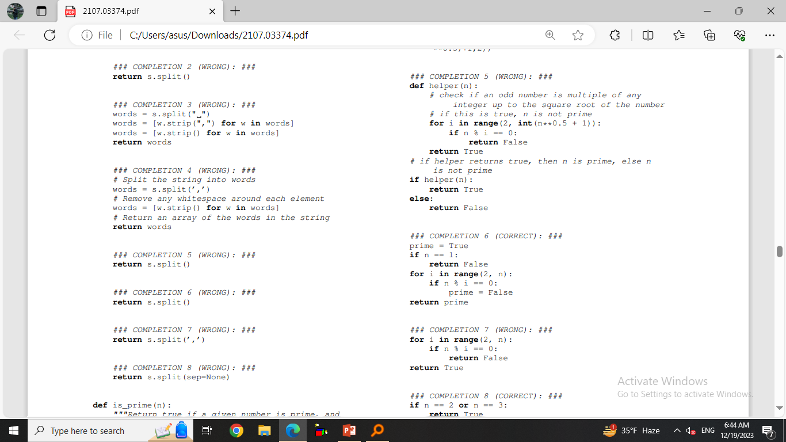
Some Examples of Codex-12B - contd

Slide 17
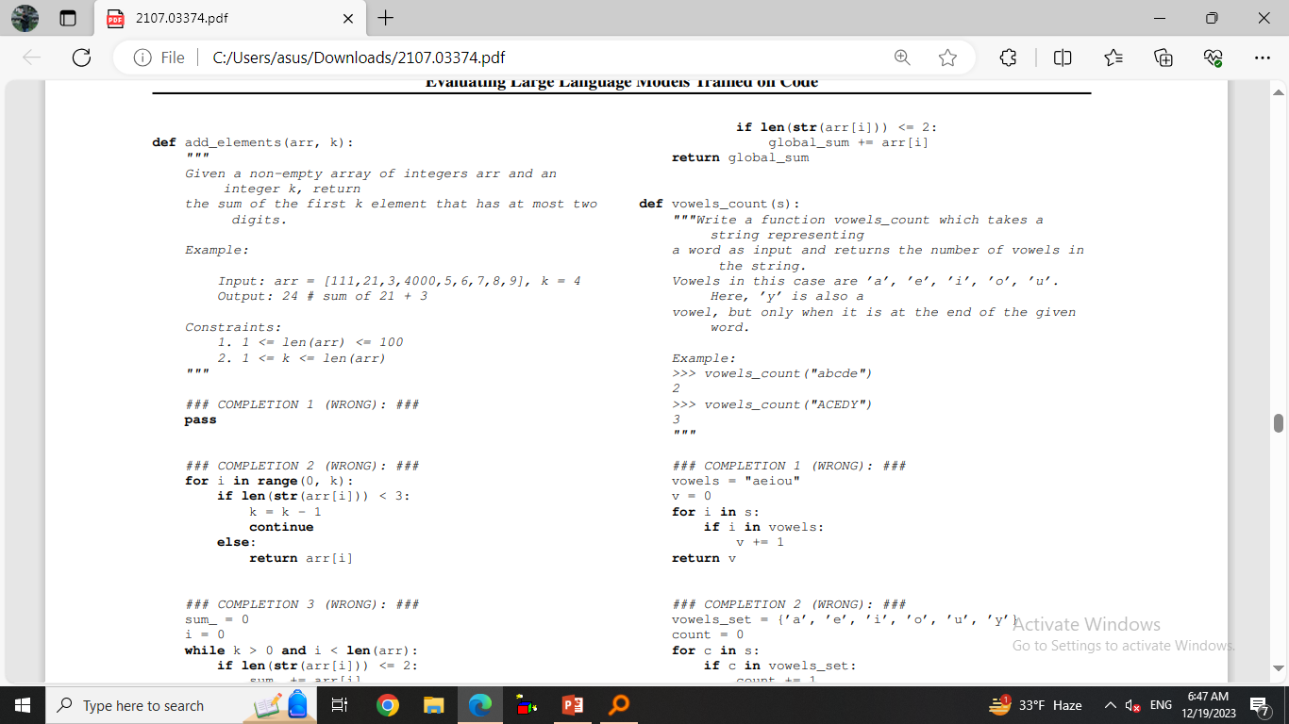
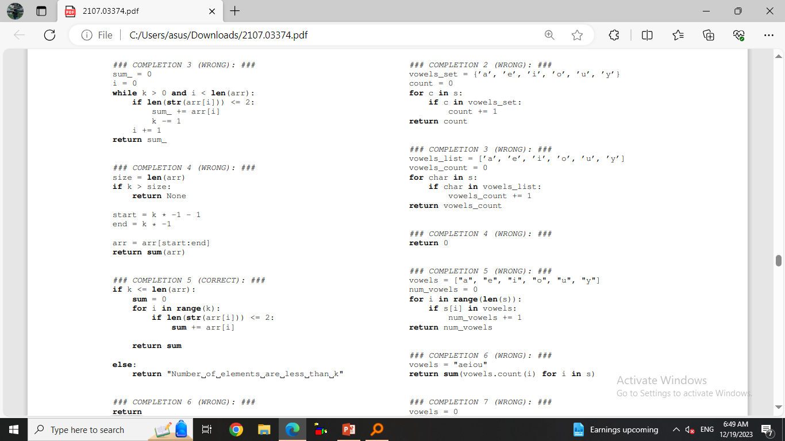
Some Examples of Codex-12B - contd

Slide 18
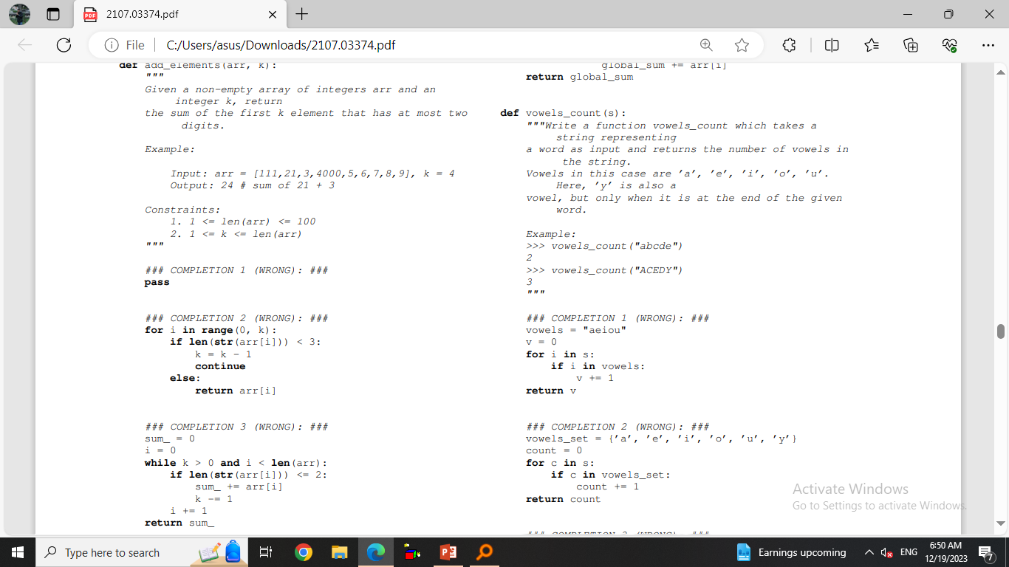
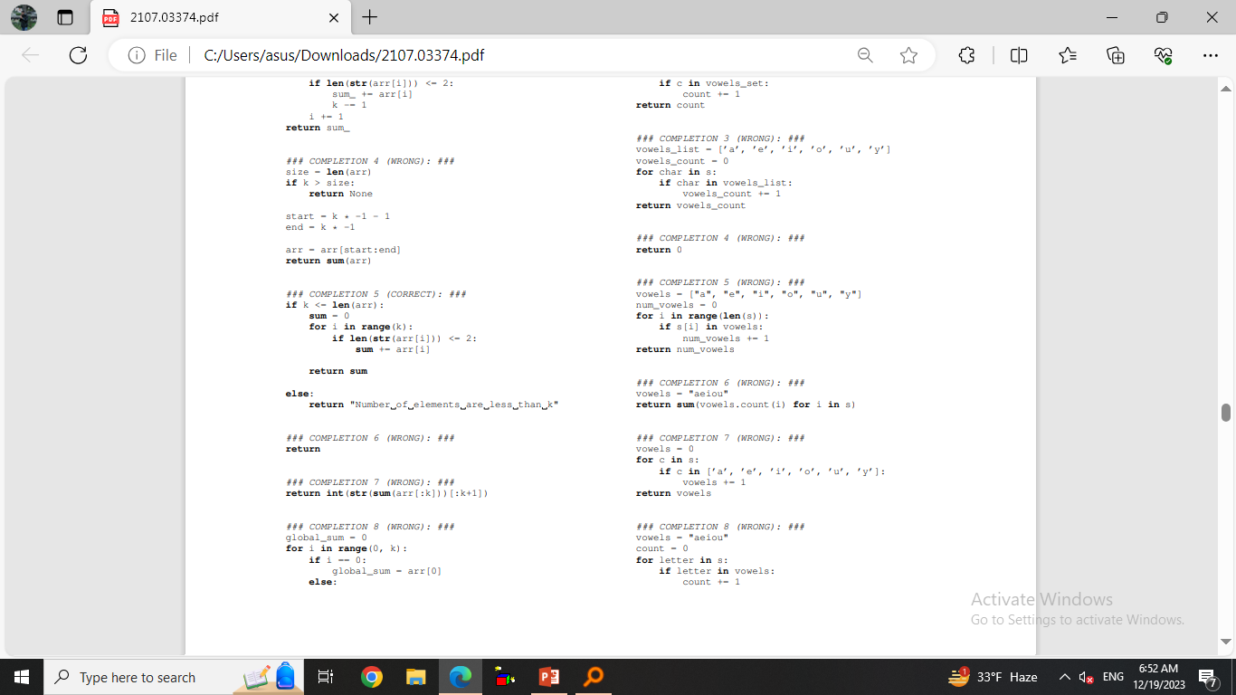
Some Examples of

Slide 19
Some Building Blocks and their Usages
We describe the 13 building blocks used to create synthetic tasks for evaluating model performance as a function of docstring complexity. Each building block is specified by a line of text and a line of code.

Slide 20
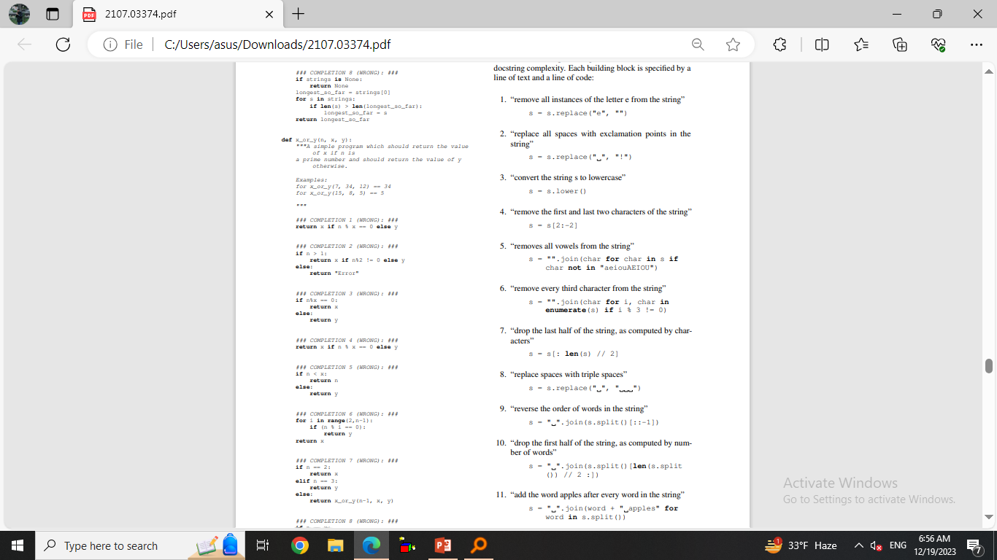
Some Examples of

Slide 21
